Slide 1


Slide 2
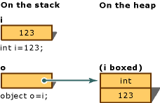
Boxing
It is used to store value types in the garbage-collected heap.
An implicit conversion of a value type to the type object.
Boxing a value type allocates an object instance on the heap and copies the value into the new object.

Slide 3
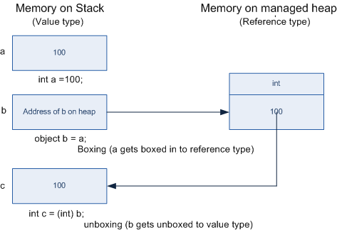
Unboxing
It is an explicit conversion from the type object to a value type.
The object instance is checked to make sure that it is a boxed value of the given value type.
Then the value from the instance is copied into the value-type variable

Slide 4
Sample Code
double a = 230.123;
int b = 120;
decimal c = 158;
string demo = "Boxing and Unboxing";
List<object> obj = new List<object>();
obj.Add(a);
obj.Add(b);
obj.Add(c);
obj.Add(demo);
//From line 15 to 19 it shows how different value type values can be boxed into the Class Object.
foreach(var item in obj){
Console.WriteLine(item);
}
//As per Unboxing, if we want to perform some math operation on the data types like int, double, etc found in the object obj, such value types need to be explicitly unboxed.
double sum =0;
sum+= (double)obj[0]*(int)obj[1];
Console.WriteLine("The sum is "+sum);

